Slide 1

Department of Computer Science and Engineering
Enhanced Optimized CNN Based Automated
Diabetic Retinopathy Detection
PRESENTED BY
Teja Sri Vankayala 21471A05D3
Venkayamma Akkapalli 21471A05D8
Eswar Kalyani Karna 21471A0594
Under the Guidance of,
Sireesha Moturi _{B.Tech., M.Tech., Ph.D.}
Assoc. Prof,
Department of Computer Science and Engineering,
Narasaraopeta Engineering College (Autonomous),
Narasaraopet- 522 601.

Slide 2
OUTLINE
Abstract
Introduction
Literature Survey
Research Gaps
Problem Statement
Objectives
Block Diagram / Flow Diagram
Methodology
Implementation
Results and Analysis
Conclusion & Future Scope
References
Question and Answers
Acknowledgements

Slide 3
ABSTRACT
Early identification is essential to prevent serious visual impairment in diabetic patients as Diabetic Retinopathy (DR) is the main reason for blindness. In this paper, an optimal Convolutional Neural Network (CNN) model is used to propose an automated approach for categorizing the stages of DR. The pre-trained VGG16 model uses deep feature extraction for the given retinal pictures, which uses scaling and feature selection heuristics by the Grey Wolf Optimizer. Those selected features from GWO belonging to the most relevant features would also give a better boost to the classification performance along with the optimization of both hyperparameters. The proposed model will perform better than the traditional techniques based on the experimental results of the precision, recall, and F1 scores. It has an accuracy of 99.31% on the DR dataset. The inclusion of GWO in CNN, models holds tremendous potential for use in the analysis of medical images and yields Optimized CNN, an efficient technique that is effective in improving healthcare

Slide 4
INTRODUCTION
Focuses on addressing Diabetic Retinopathy (DR), a leading cause of blindness.
Proposes an automated detection system utilizing an Optimized Convolutional Neural Network (OpCoNet).
Employs Grey Wolf Optimizer (GWO) for feature selection and hyperparameter tuning.
Highlights the combination of advanced deep learning techniques to improve diagnostic accuracy and efficiency.
The global rise in diabetes necessitates efficient screening and diagnostic tools for early detection of DR.
Traditional methods are often time-consuming, less accurate, and prone to human error.

Slide 5
The need for scalable, automated solutions to assist healthcare providers in resource-limited settings.
Advances in AI and deep learning offer promising opportunities for enhancing medical diagnostics.
Provides a cost-effective, accurate, and reliable method to screen for and classify stages of DR.
Demonstrates the effective integration of pre-trained models (like VGG16) with optimization algorithms (e.g., GWO).
Enhances accessibility in clinical environments, reducing the burden on healthcare professionals.
The model achieves a 99.31% accuracy rate, showcasing its potential for real-world implementation.

Slide 6
LITERATURE SURVEY
No | Title | Author | Journal Name & Year | Methodology Adapted | Key Findings | Gaps
1 | A Deep Learning Approach for the Diabetic Retinopathy Detection | R. Sebti, M. Fakir, M. Rziza | Springer, 2019 https://doi.org/10.1007/978-3-030-94191-8_37 | CNN optimized with Grey Wolf Optimizer (GWO) | Achieved 96.03% accuracy in detection. | Limited dataset size (3662 images). Class imbalance
2 | Diabetic Retinopathy Detection from Fundus Images of the Eye Using Hybrid Deep Learning Features | S. S. R. Abidi, M. A. Al-Ghaili, M. A. Al-Waisy, R. S. Al-Fahdawi, et al. | Diagnostics, 2022 https://www.mdpi.com/2075-4418/12/7/1607 | Hybrid model combining CNN and handcrafted features. | Achieved 98.6% accuracy on DIARETDB1 dataset. | The model's performance on larger datasets remains untested.
3 | Retinal Fundus Image Classification for Diabetic Retinopathy Using Transfer Learning Technique | F. Kallel, A. Echtioui | Springer, 2024 https://link.springer.com/article/10.1007/s11760-023-02820-8 | Transfer learning with pretrained models (VGG16, InceptionV3, DenseNet169). | InceptionV3 achieved 96.88% accuracy. | Limited dataset diversity and real-world testing.

Slide 7
No | Title | Author | Journal Name & Year | Methodology Adapted | Key Findings | Gaps
4 | Diabetic Retinopathy Improved Detection Using Deep Learning | Ayala, J. A., Ortiz Figueroa, T., Fernandes, B., Cruz, F. | MDPI, 2021 https://www.mdpi.com/2076-3417/11/24/11970 | Used CNN and hybrid methods to improve DR detection on public datasets. | Achieved improved classification metrics on datasets like APTOS and Messidor-2. | Does not explore specific hyperparameter tuning techniques.
5 | Automated Detection of Diabetic Retinopathy Using Optimized CNN | S. Minija, R. Mary, S. B. Ross | Springer, 2023 https://doi.org/10.1007/ s11042-023-16204-0 | Optimized CNN model with feature selection for improved classification of DR stages. | Achieved accuracy of 99.4% on a proprietary dataset. | Limited public dataset benchmarks and comparison with hybrid approaches.

Slide 8
RESEARCH GAPS
Need to explore more efficient optimization algorithms that balance computational cost and performance.
Few studies directly compare deep learning models, optimization techniques, and hybrid methods, creating a gap in standardized benchmarks.
Hybrid models combining CNN and handcrafted features lack a detailed exploration of feature fusion mechanisms.
Models like CNNs and hybrid approaches achieve high accuracy but there is variability in performance across different datasets.
Prediction rates for some models are not benchmarked, leaving uncertainty about their applicability in real-time clinical environments.

Slide 9
PROBLEM STATEMENT
Diabetic Retinopathy (DR) datasets often face class imbalance, leading to biased predictions and limited generalizability. Existing deep learning models struggle with high-dimensional feature spaces, causing computational inefficiencies. While techniques like Grey Wolf Optimizer (GWO) enhance performance, they can introduce overhead, limiting scalability for real-time use. Additionally, many models lack adaptability to diverse datasets and clinical settings. Effective solutions must address class imbalance, optimize feature selection, and improve efficiency to ensure high accuracy and scalability for real-world applications.

Slide 10
OBJECTIVES
Use advanced class balancing techniques, such as class weights, SMOTE (Synthetic Minority Over-sampling Technique), or cost-sensitive learning, to overcome biased predictions and improve model generalizability.
Implement optimization algorithms, such as Grey Wolf Optimizer (GWO) or Ant Colony Optimization (ACO), to reduce high-dimensional feature spaces and extract only the most relevant features for classification.
Design a model that can effectively handle diverse datasets, including variations in image quality, resolution, and class distributions, ensuring robust performance in clinical settings.
Ensure the model meets clinical requirements by maintaining high accuracy, low false positives/negatives, and efficient processing times for real-time usability.
Incorporate techniques like dropout, early stopping, and regularization to prevent overfitting, especially on small or imbalanced datasets.

Slide 11
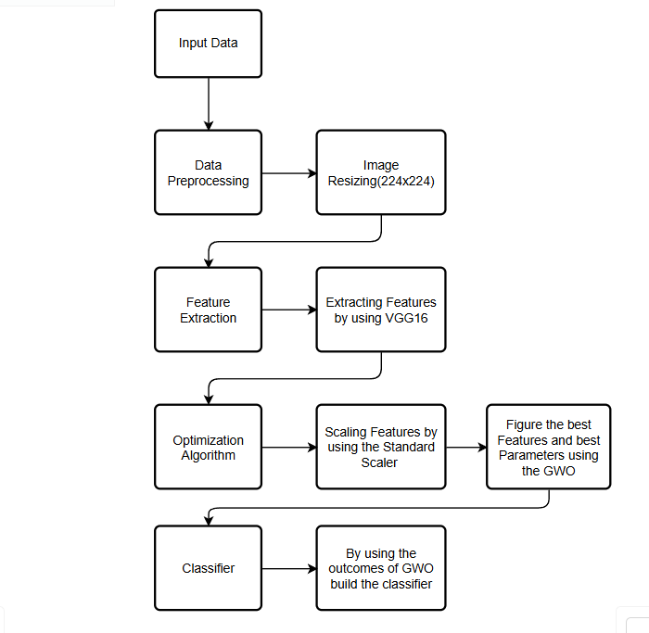
BLOCK DIAGRAM OR FLOW DIAGRAM
Prediction

Slide 12
METHODOLOGY
Dataset Description
Data Preprocessing
Feature Extraction
Gray Wolf Optimization
Optimized CNN

Slide 13
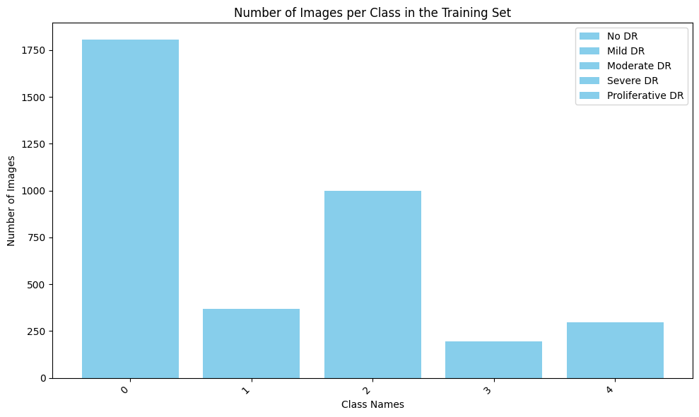
Dataset Description
The "Diabetic Retinopathy Level Detection" dataset from Kaggle contains 4,396 retinal images. The Training set contains 3662 images and the testing set contains 734 images
These images are categorized into five levels of severity of diabetic retinopathy (DR).
Level 0
Level 1
Level 2
Level 3
Level 4

Slide 14
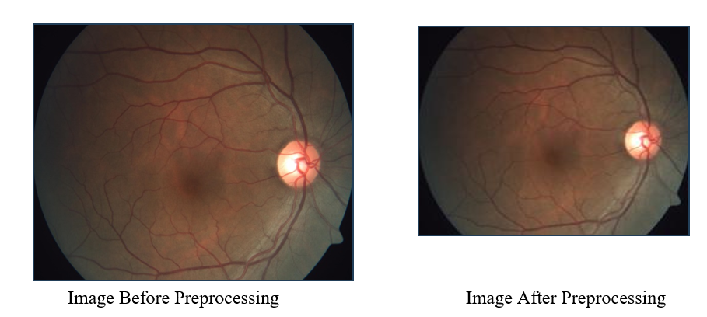
2. Data Pre Processing
The Diabetic Retinopathy Level Detection dataset contains high-quality images.
Images are resized and processed in batches to enhance computational efficiency and feature extraction.
Class weights are computed to handle class imbalance, reducing bias in model training.
Data splitting is not required as the dataset is already pre-divided.
No data augmentation techniques (e.g., rotations or flips) are applied, relying only on preprocessing steps.

Slide 15
3. Feature Extraction
The VGG16 model, a pre-trained CNN developed by the Oxford Visual Graphics Group, is used for deep feature extraction.
It consists of 16 layers and is widely used for image categorization tasks.
Pixel values are normalized to a range between 0 and 1.
The Image Data Generator is used for scaling and normalization.
The model is loaded with weights from the ImageNet dataset for effective feature extraction.
The output is a set of deep features for each image, along with their labels.
Extracted features and labels are saved to disk, reducing the need to rerun images through the VGG16 model.
This approach saves computational time and facilitates faster classification and training of additional classifiers.

Slide 16
4. Gray Wolf Optimization
The Gray Wolf Optimizer (GWO) is an optimization algorithm inspired by gray wolves' hierarchical structure and hunting strategies.
GWO optimizes parameters and simplifies feature selection for high-dimensional datasets, improving model performance.
Standard scaling was applied to the dataset to ensure consistent feature comparison.
A binary feature selection mask was used, where '1' indicates a selected feature and '0' excludes it.
Class weights were calculated to address data imbalance and prevent bias in the CNN model.

Slide 17
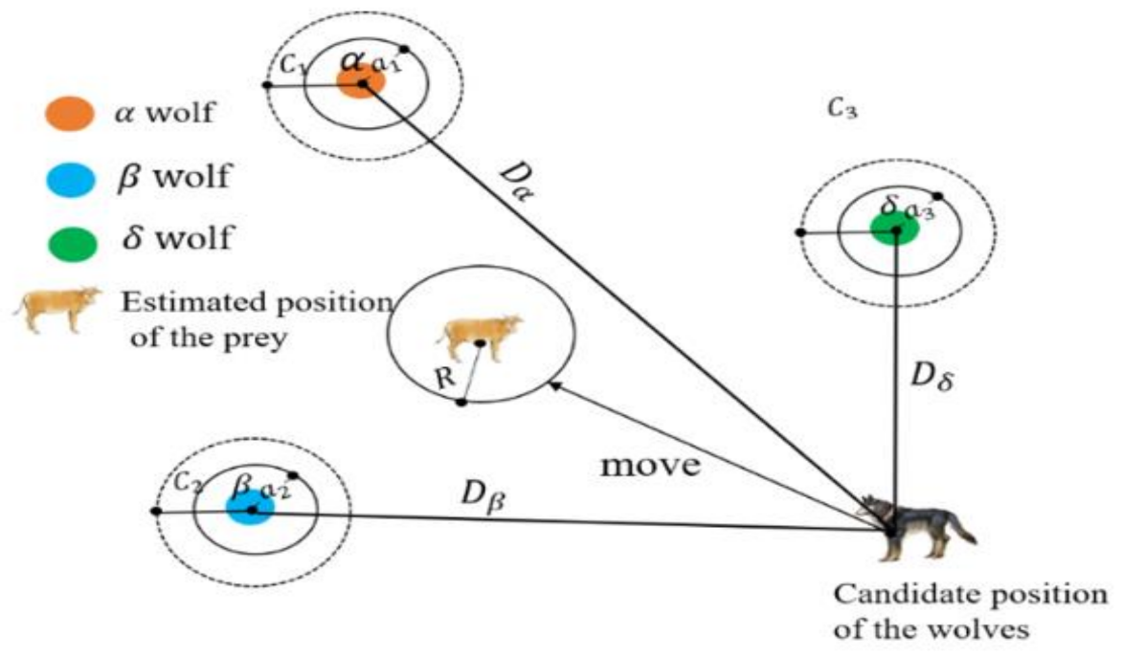
GWO optimized hyperparameters, including the number of neurons in dense layers, learning rate, dropout rate, and selected features.
The dataset initially had 25,088 features per image; GWO reduced this to 10,316 features, significantly lowering dimensionality.
The algorithm was executed with 10 wolves over 20 iterations, focusing on feature contribution to validation accuracy.

Slide 18
5. Optimized CNN
The optimized CNN is designed to classify diabetic retinopathy (DR) stages effectively.
It starts with an input layer that processes selected features extracted from the dataset.
The model includes dense layers where neurons perform weighted sums and apply activation functions to learn complex patterns.
Batch normalization is applied after dense layers to stabilize and speed up the training process.
Dropout layers are used to randomly disable neurons during training, reducing the risk of overfitting.
A final convolutional layer applies filters to capture complex patterns, followed by pooling to preserve essential information.

Slide 19
The output layer uses a SoftMax activation function to produce a probability distribution for classification.
The model architecture ensures faster convergence and better generalization through hyperparameter tuning.
Early stopping is implemented to prevent overtraining and ensure a balanced, accurate predictive model.
Hyper Parameters | Value
Neurons_Layer1 | 181
Learning Rate | 0.0004572052659916009
Neurons_Layer2 | 150
Optimizer | Adam
Dropout_Rate | 0.1
L2 Regularization | 0.001
Loss | Categorical Cross Entropy

Slide 20
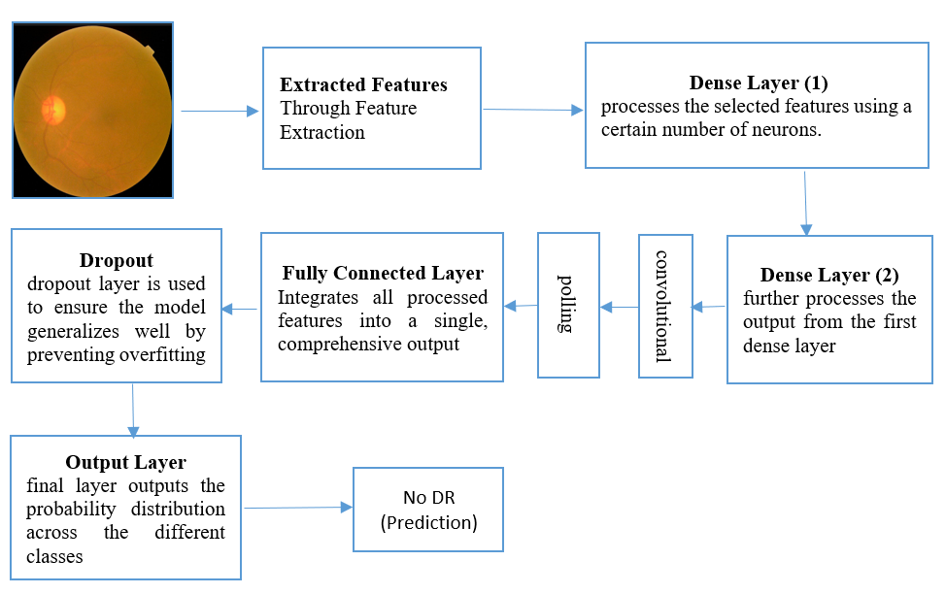

Slide 21
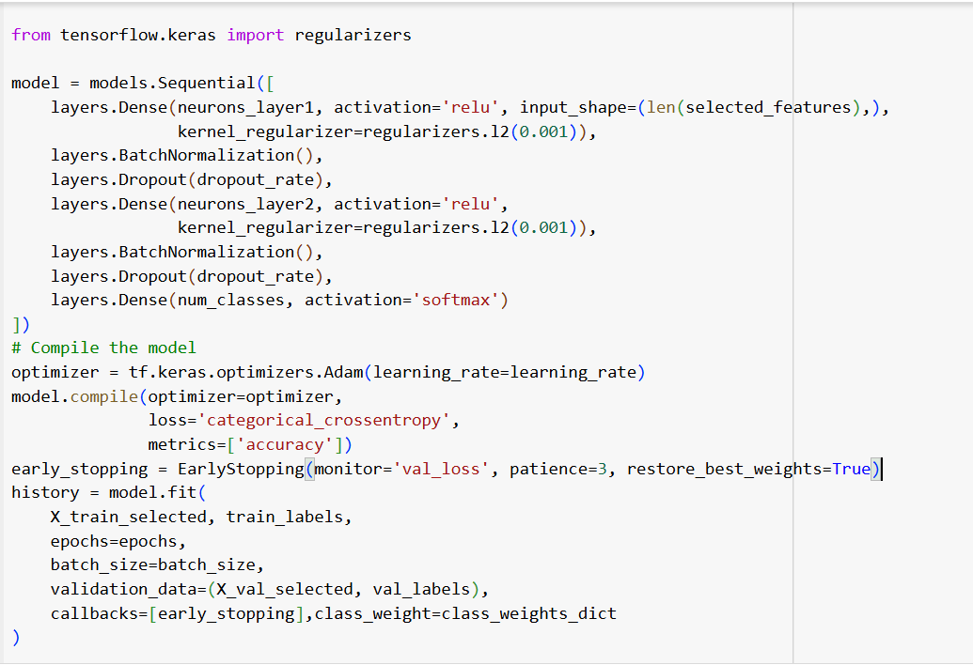
IMPLEMENTATION

Slide 22
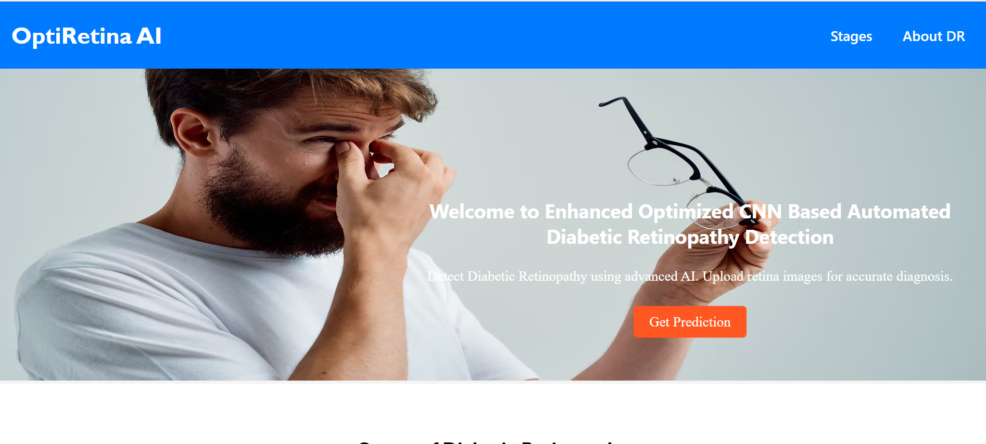
Implementation of Front End- Home Screen

Slide 23
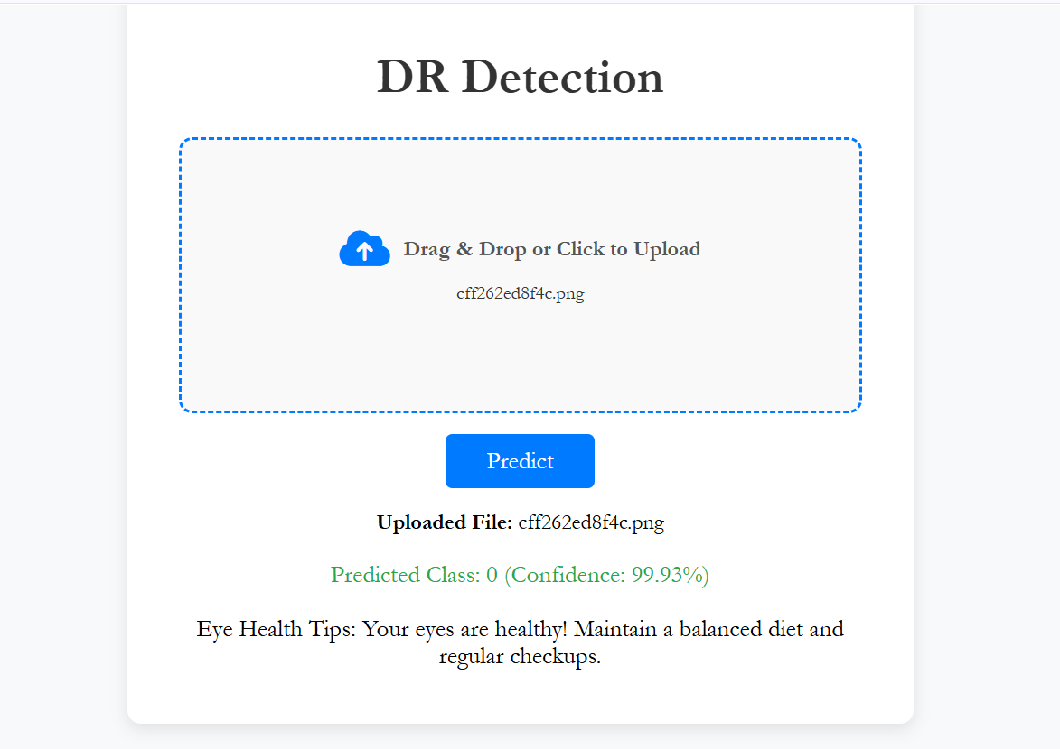
Implementation of Front End – Output Screen

Slide 24
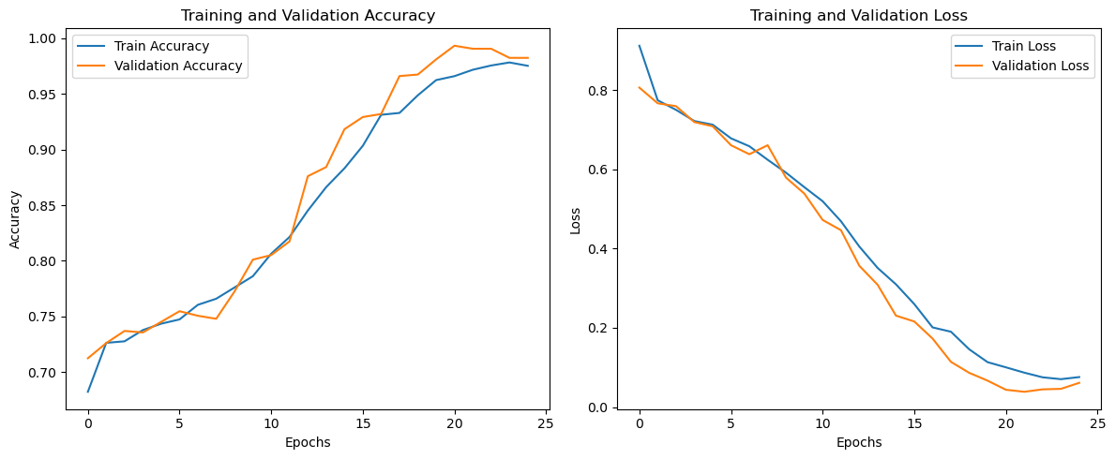
RESULTS & ANALYSIS
OpCoNet With Images (GWO)
The best hyperparameters obtained using the Gray Wolf Optimization algorithm were used to build the OpCoNet.
This network accepts images as input and achieves an impressive accuracy of 98.23% on a dataset containing 3,662 images.

Slide 25
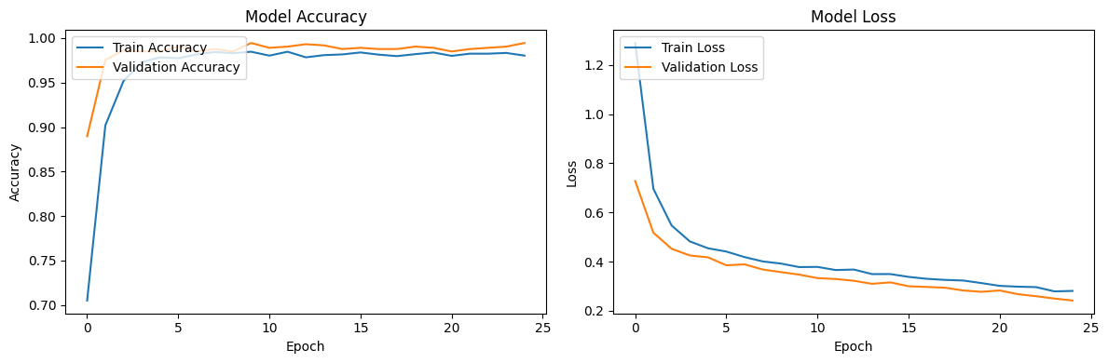
2. OpCoNet With ACO Selected Features
Ant Colony Optimization (ACO) operates similarly to Gray Wolf Optimization (GWO) but employs a different strategy for selecting features.
Using the hyperparameters derived from ACO, the Optimized CNN (OpCoNet) was built, selecting approximately 12,565 features from the initial 25,088 features per image.
This optimized feature set enabled the model to achieve an impressive accuracy of 99.45% on a dataset of 3,662 images.

Slide 26
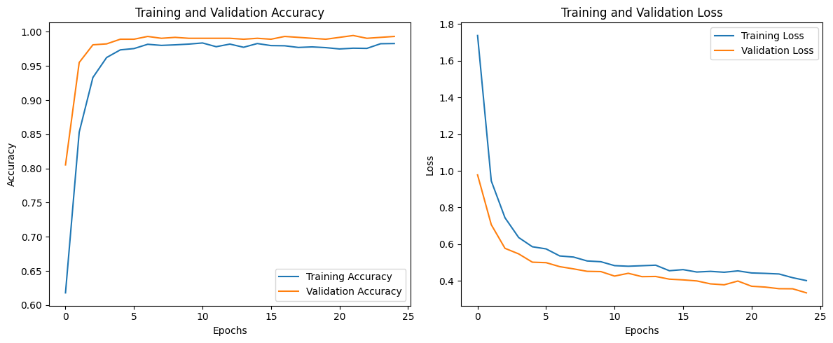
3. OpCoNet With GWO Selected Features
The Gray Wolf Optimization algorithm identified the best hyperparameters to build the Optimized CNN (OpCoNet), which accepts extracted features as input.
Initially, each image had approximately 25,088 features, but the GWO reduced the feature set to 10,316 features. With this optimized feature set, the OpCoNet achieved an impressive accuracy of 99.31% on a dataset of 3,662 images.

Slide 27
Methodology | No of the Features Selected | Epochs | Accuracy | Time Comparison
Training With Images (GWO) | Nill | 25 | 98.23 | 3 Hours
Training With All Extracted Features (GWO) | All (25088) | 30 | 99.18 | 48.221Sec
Training With GWO Selected Features | 10316 | 25 | 99.31 | 27.279 Sec
Training With ACO Selected Features | 12565 | 25 | 99.45 | 28.366 Sec
CNN | Nill | 25 | 96.03 | 3 Hours
OpcoNet With All Extracted Features (ACO) | All (25088) | 25 | 98.91 | 76.799 Sec

Slide 28
CONCLUSION and FUTURE SCOPE
The optimized CNN combined with Grey Wolf Optimizer (GWO) effectively classified diabetic retinopathy stages with 99.31% accuracy.
Feature selection using GWO significantly reduced dimensionality and computational costs.
The model demonstrated scalability and robustness, making it suitable for clinical applications.
Early stopping and class weights improved generalization and reduced overfitting risks.
Address challenges from high-resolution images by standardizing dimensions or employing compression techniques.
Mitigate overfitting risks by using synthetic data generation or cost-sensitive learning for small or imbalanced datasets.
Optimize the model for resource-constrained environments by reducing hardware requirements.
Test the model on larger, more diverse datasets to validate its robustness and generalizability
.

Slide 29
REFERENCES
1. Sebti, R., Zroug, S., Kahloul, L., & Benharzallah, S. (2021, November). “A deep learning approach for the diabetic retinopathy detection”. In The Proceedings of the International Conference on Smart City Applications (pp. 459-469). Cham: Springer International Publishing. https://doi.org/10.1007/978-3-030-94191-8_37.
2. Ayala, A., Ortiz Figueroa, T., Fernandes, B., & Cruz, F. (2021). “Diabetic retinopathy improved detection using deep learning”. Applied Sciences, 11(24), 11970. https://doi.org/10.3390/app112411970
3. Saxena, G., Verma, D. K., Paraye, A., Rajan, A., & Rawat, A. (2020). “Improved and robust deep learning agent for preliminary detection of diabetic retinopathy using public datasets”. Intelligence-Based Medicine, 3, 100022. https://doi.org/10.1016/j.ibmed.2020.100022
4. Jabbar, A., Liaqat, H. B., Akram, A., Sana, M. U., Azpíroz, I. D., Diez, I. D. L. T., & Ashraf, I. (2024). “A Lesion-Based Diabetic Retinopathy Detection Through Hybrid Deep Learning Model”. IEEE Access.
5. Farooq, M. S., Arooj, A., Alroobaea, R., Baqasah, A. M., Jabarulla, M. Y., Singh, D., & Sardar, R. (2022). Untangling computer-aided diagnostic system for screening diabetic retinopathy based on deep learning techniques. Sensors, 22(5), 1803. https://doi.org/10.3390/s22051803.

Slide 30
6. Butt, M. M., Iskandar, D. A., Abdelhamid, S. E., Latif, G., & Alghazo, R. (2022). Diabetic retinopathy detection from fundus images of the eye using hybrid deep learning features. Diagnostics, 12(7), 1607. https://doi.org/10.3390/diagnostics12071607
7. Dai, L., Sheng, B., Chen, T., Wu, Q., Liu, R., Cai, C., ... & Jia, W. (2024). A deep learning system for predicting time to progression of diabetic retinopathy. Nature Medicine, 30(2), 584-594. https://doi.org/10.1038/s41591-023-02702-z
8. Baba, S. M., Bala, I., Dhiman, G., Sharma, A., & Viriyasitavat, W. (2024). Automated diabetic retinopathy severity grading using novel DR-ResNet+ deep learning model. Multimedia Tools and Applications, 1-43. https://doi.org/10.1007/s11042-024-18434-2
9. Jagadesh, B. N., Karthik, M. G., Siri, D., Shareef, S. K., Mantena, S. V., & Vatambeti, R. (2023). Segmentation Using the IC2T Model and Classification of Diabetic Retinopathy Using the Rock Hyrax Swarm-Based Coordination Attention Mechanism. IEEE Access.
10. Kallel, F., & Echtioui, A. (2024). Retinal fundus image classification for diabetic retinopathy using transfer learning technique. Signal, Image and Video Processing, 18(2), 1143-1153. https://doi.org/10.1007/s11760-023-02820-8 .

Slide 31
11. Moturi, S., Vemuru, S., Tirumala Rao, S.N., Mallipeddi, S.A. (2023). Hybrid Binary Dragonfly Algorithm with Grey Wolf Optimization for Feature Selection. In: Hassanien, A.E., Castillo, O., Anand, S., Jaiswal, A. (eds) International Conference on Innovative Computing and Communications. ICICC 2023. Lecture Notes in Networks and Systems, vol 703. Springer, Singapore. https://doi.org/10.1007/978-981-99-3315-0 47
12. Minija, S. J., Rejula, M. A., & Ross, B. S. (2024). Automated detection of diabetic retinopathy using optimized convolutional neural network. Multimedia Tools and Applications, 83(7), 21065-21080. https://doi.org/10.1007/s11042-023-16204-0
13. Mirjalili, S., Mirjalili, S. M., & Lewis, A. (2014). "Grey wolf optimizer." “Advances in Engineering Software”, 69, 46-61. https://doi.org/10.1016/j.advengsoft.2013.12.007.
14. M.Sireesha, S. N. Tirumala Rao, Srikanth Vemuru, Optimized Feature Extraction and Hybrid Classification Model for Heart Disease and Breast Cancer Prediction International Journal of Recent Technology and Engineering Vol - 7, No 6, Mar - 2019 ISSN - 2277-3878, Pages 1754 – 1772
15. Sireesha Moturi, S.N.Tirumala Rao, Srikanth Vemuru, Grey wolf assisted dragonfly-based weighted rule generation for predicting heart disease and breast cancer, Computerized Medical Imaging and Graphics, Volume 91, 2021, 101936, ISSN 0895-6111

